Slide 1
Whitbook Database
Bishesh, Xavier, Phuc, Nhat

Slide 2

Introduction
Social media app for interaction with users and post
Database to store the user information
Purpose of micro-blogging
Application has GUI interface for interaction with the user

Slide 3

Database Schema
CREDENTIAL(UserName, ID, Password, Email)
USER (ID, UserName, FName, Lname, Gender, Dbirth, DateCreated)
POST(PostID, Content)
ACTION(ActionID, UserID, PostID, Time, ActionDesc)
FOLLOWEE(UserID, FolloweeID)

Slide 4

Application of the Project
Micro-Blogging
Social platform for connections
Making Campus group
Information and Update on Events

Slide 5
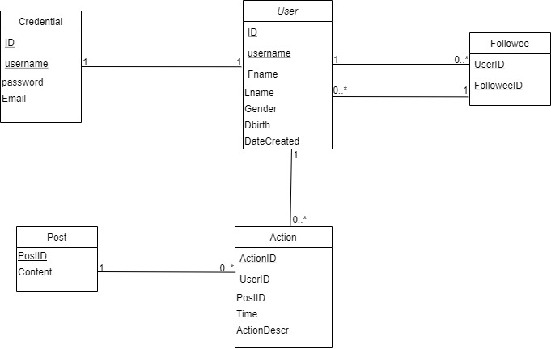
UML Diagram

Slide 6

Challenges
User Interface
SQL queries
Populating the database
Debugging of UI

Slide 7
Thank You !

